Slide 1
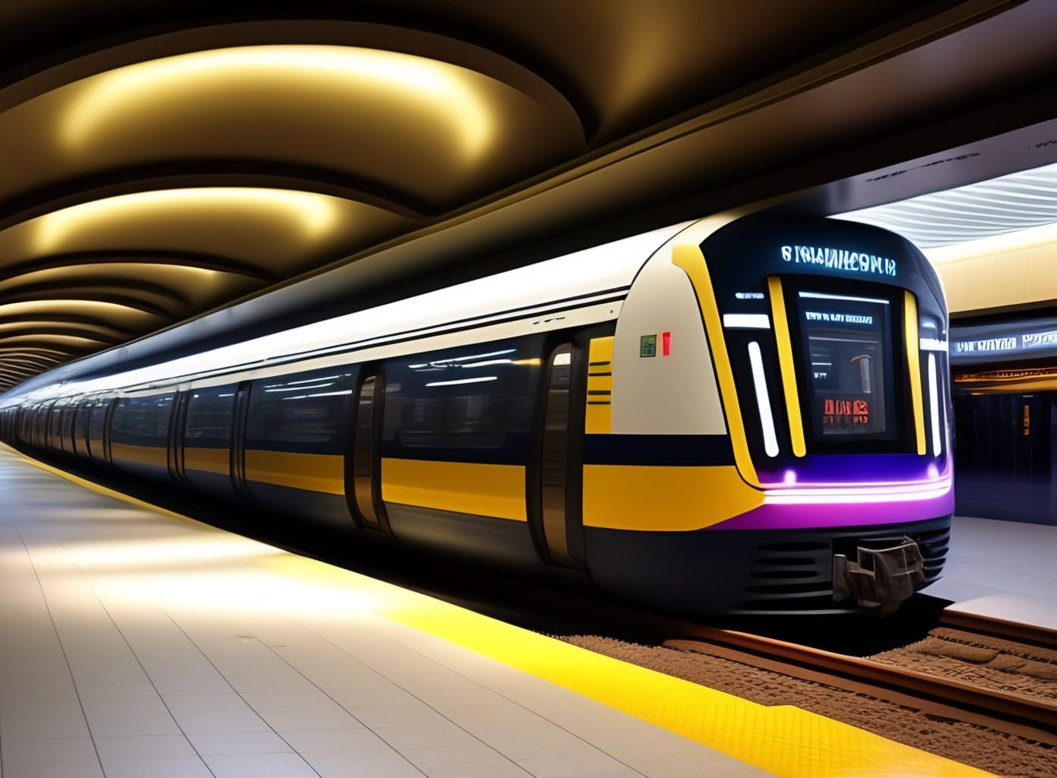




RETAIL ANALYSIS

Slide 2
MECE ON RETAIL ANALYSIS
Sales Trend Over Time
Product Category wise Sales
Geographically Sales Distribution
Top Selling Products
Product Scale Analysis
Stock Analysis
Order Completion Analysis
Order Distribution Analysis
Order Processing Time
Product Performance Analysis
Sales Analysis
Order Analysis
Customer
Analysis
Payment Analysis
Customer Order Behavior
Top 10 Customers by Sales
Demographic Analysis Customer
Customer Payment Behavior
Payment Completion Rate
Payment Processing Time

Slide 3
OBJECTIVE
Sales Analysis: Understand sales trends, top products, and channel effectiveness.
Product Analysis: Evaluate category popularity, pricing impact, and diversification opportunities.
Customer Analysis: Segment by demographics, analyze behavior, and tailor strategies.
Payment Analysis: Investigate preferred methods and optimize for customer satisfaction.
Order Analysis: Assess processing efficiency, accuracy, and streamline fulfillment processes.

Slide 4
EDA PROBLEM

Slide 5

Which factors contribute to the highest sales in a particular region?
Insight: Europe has the highest sales among all regions and it has maximum credit limit and number of orders is also highest in the Europe Region Reasons for Highest Sales: High Consumption of goods (49578)
and High Credit Limit Offered (16,62,75,200)

Slide 6
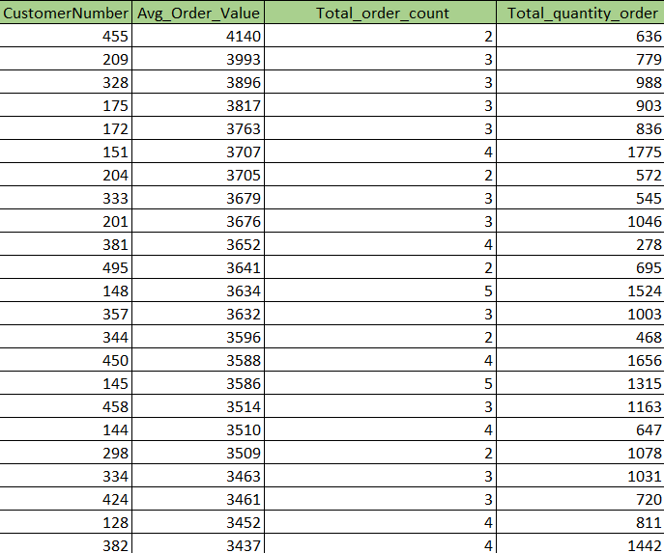
How can customer purchasing patterns be influenced to increase average order value?
Insight: By analysing the data, we have conclude the high-value customers and their buying habits. This insight guides targeted marketing and sales tactics, such as exclusive promotions, product bundles, and personalized suggestions, to boost their spending and raise the average order value.

Slide 7
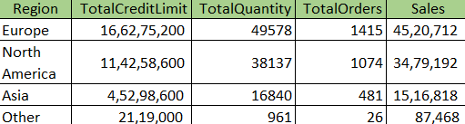
What are the key drivers of sales growth, and how can they be leveraged for future success?
Key drivers of sales growth include:
Total Credit Limit
Total Quantity Sold
Order Frequency
Total Revenue Generated

Slide 8

Which product features or attributes are most appealing to customers?
Note: Taken top 5 orders Insights: S18_3232 (1992 Ferrari 360 Spider red) has the most order So this attributes is most appealing to customers
Product Feature of 1992 Ferrari 360 Spider red His replica features opening doors, superb detail and craftsmanship, working steering system, opening forward compartment, opening rear trunk with removable spare, 4 wheel independent spring suspension as well as factory baked enamel finish.

Slide 9
How can the product mix be optimized to cater to changing market demands?
Optimizing the product mix to cater to changing market demands is a critical process that requires a combination of
Market Research and Analysis
Establish Clear Objectives
Marketing and Promotion
Pricing Strategy
Supply Chain Optimization
Product Development and Innovation

Slide 10
Market Research and Analysis
Pricing Strategy
Establish Clear Objectives
Product Development
and Innovation
Marketing and Promotion
Supply Chain Optimization
Notes:
My name is Akshay

Slide 11
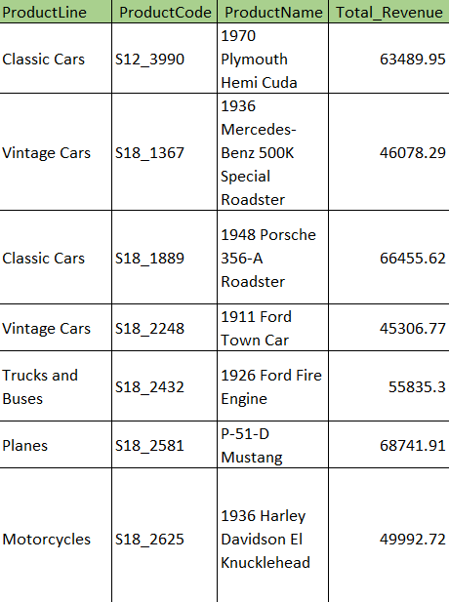
Are there any specific market segments where a particular product is underperforming, and how can it be improved?
Insight: A critical observation reveals that the following products are underperforming, as the cumulative revenue from these products falls short of the average revenue earned across all products.

Slide 12
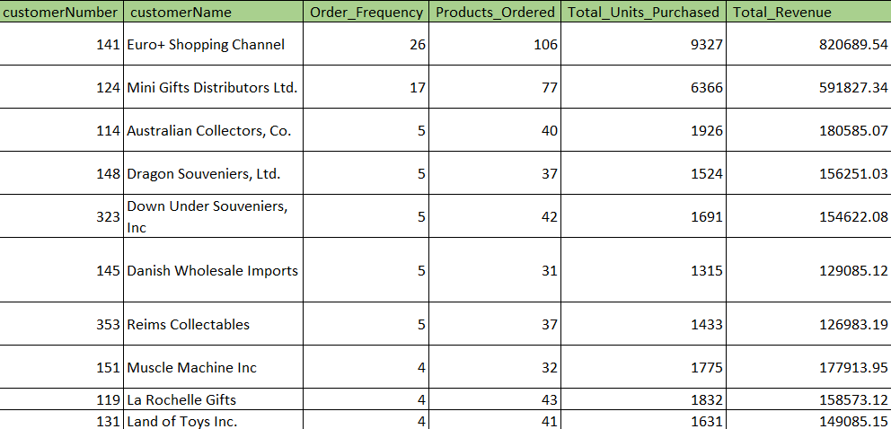
What are the main factors that influence customer loyalty and repeat purchases?
Insight: Customer loyalty and repeat purchases are influenced by:
1. Product/Service Quality
2. Customer Service 3. Brand Trust
4. Discount
5. Competitive Pricing
6. Feedback and Improvement
7. Loyalty Incentives
Focusing on these factors improves loyalty and encourages repeat purchases.

Slide 13
How do customer preferences differ based on geographic location, and how can marketing campaigns be customized accordingly?
Insight: Customer preferences can vary significantly based on geographic location due to cultural, economic, and environmental factors. To customize marketing campaigns effectively, businesses should consider the following:
1. Language 2. Climate and Seasonal Variation 3. Economic Factors 4. Local Trends and Traditions 5. Legal and Regulatory Compliance 6. Local Competition 7. Market Research 8. Customer Feedback

Slide 14
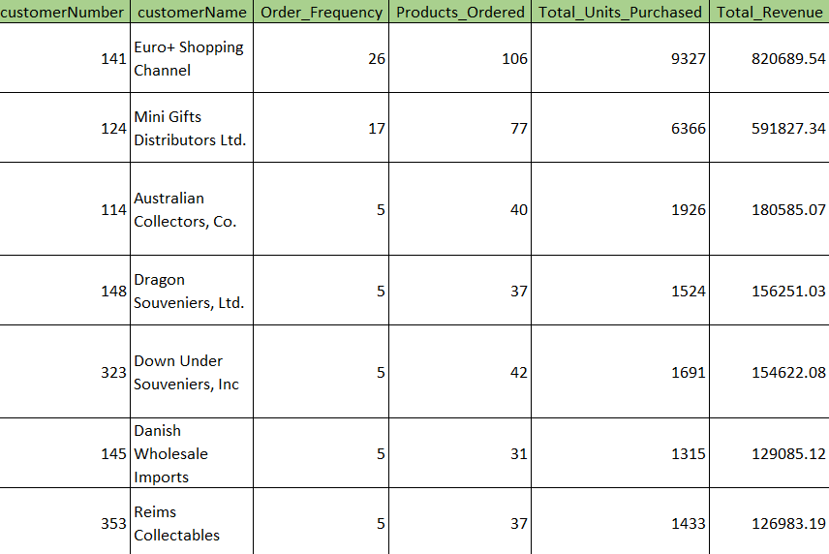
What are the characteristics of high-value customers, and how can similar customers be targeted for acquisition?
Insight:
Characteristics of High-Value Customers:
1. High Spending
2. Loyalty
3. Long-term Engagement 4. Profitability
5. Advocacy Targeting Similar Customers for Acquisition:
1. Data Analysis 2. Customer Segmentation 3. Look-alike Modelling 4. Personalized Marketing 5. Referral Programs
6. Improve Customer Experience
7. Cross-selling and Upselling
8. Retention Strategies
9. A/B Testing

Slide 15
How can marketing strategies be tailored to target specific demographic segments in different regions?
Insight: Tailoring marketing strategies to target specific demographic segments in different regions involves a combination of Market Research, Customer Segmentation, Offer Customization, Testing and Optimization, Local Partnerships and Influencers, Monitor and Measure

Slide 16
What are the potential untapped markets based on demographic indicators, and how can market penetration be increased?
Identifying potential untapped markets based on demographic indicators can be a strategic growth opportunity. Some demographic indicators are:
1. Age Groups
2. Geographic Areas
3. Cultural Background 4. Family Status 5. Income Levels 6. Gender 7. Education Level 8. Digital Adoption
To increase market penetration in these untapped markets:
1. Market Research
2. Product/Service Customization
3. Local Partnerships 4. Localized Marketing 5. Pricing and Promotions 6. Distribution Channels
7. Education and Awareness
8. Customer Feedback 9. Continuous Evaluation

Slide 17
How do customer preferences and behaviour differ based on demographic factors, and how can they be leveraged for personalized marketing campaigns?
To leverage these differences for personalized marketing:
1. Conduct thorough market research to understand the preferences of various demographic groups.
2. Segment your customer base by demographics to tailor your marketing campaigns.
3. Use data analytics to track and analyse customer behaviour, enabling dynamic personalization.
4. Craft tailored marketing messages, offers, and content that resonate with each demographic.
5. Implement A/B testing to refine your campaigns based on what works best for each group.

Slide 18
POWER BI PROBLEM

Slide 19
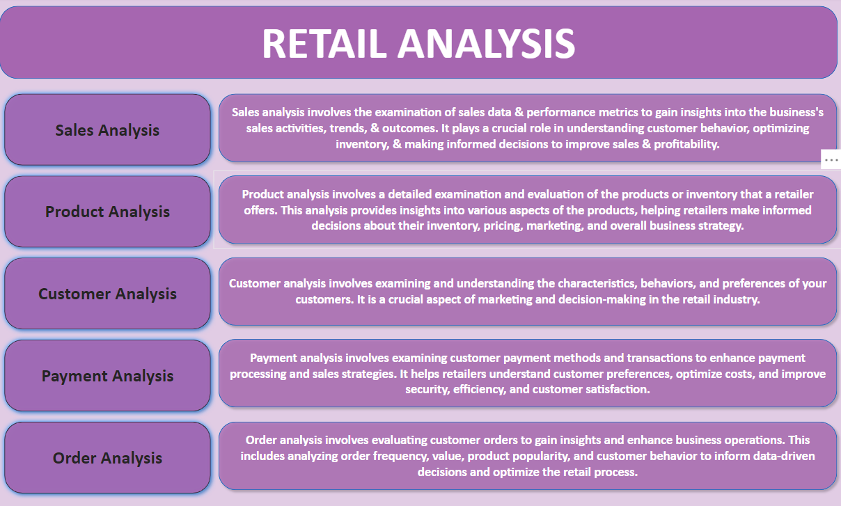

Slide 20
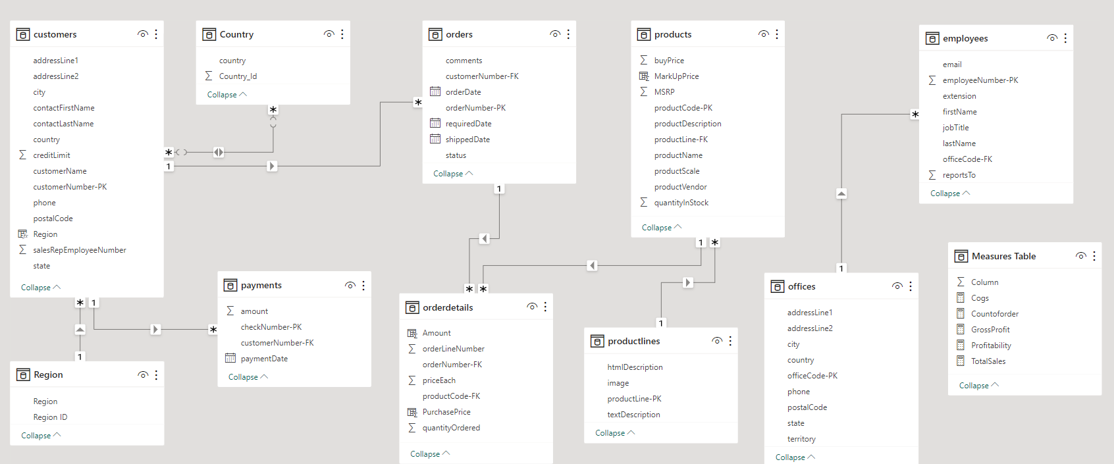
ER DIAGRAM

Slide 21
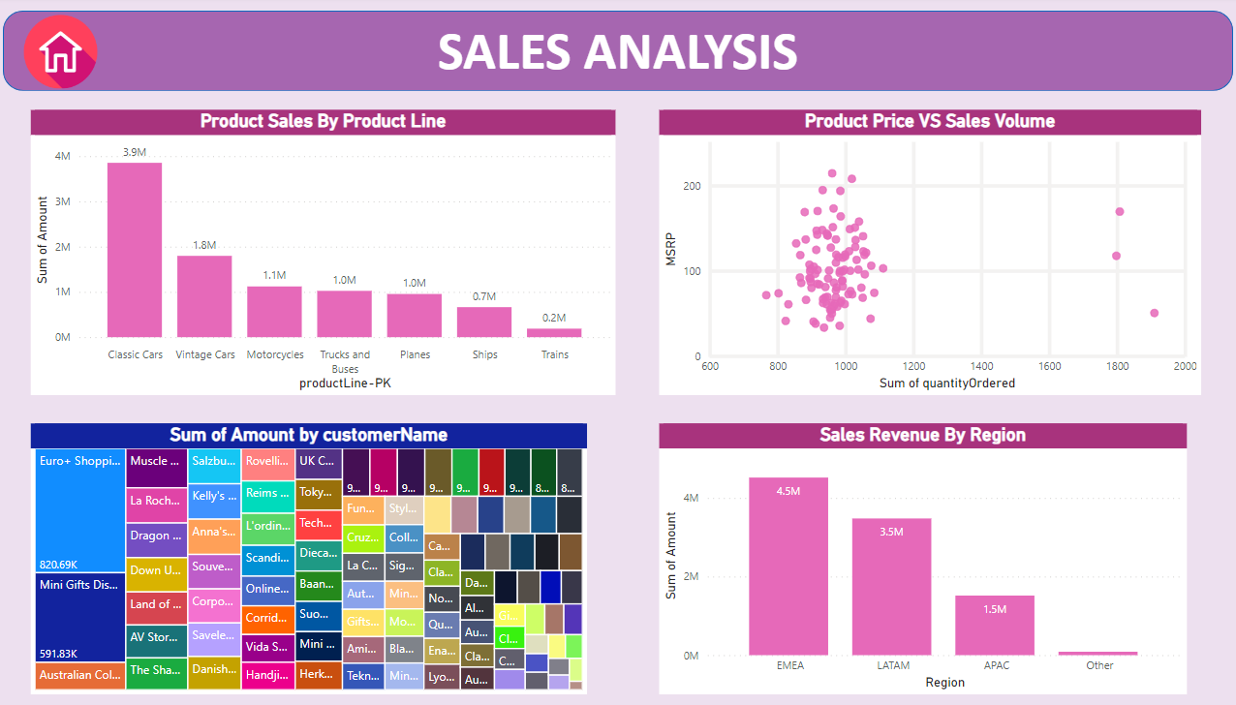

Slide 22
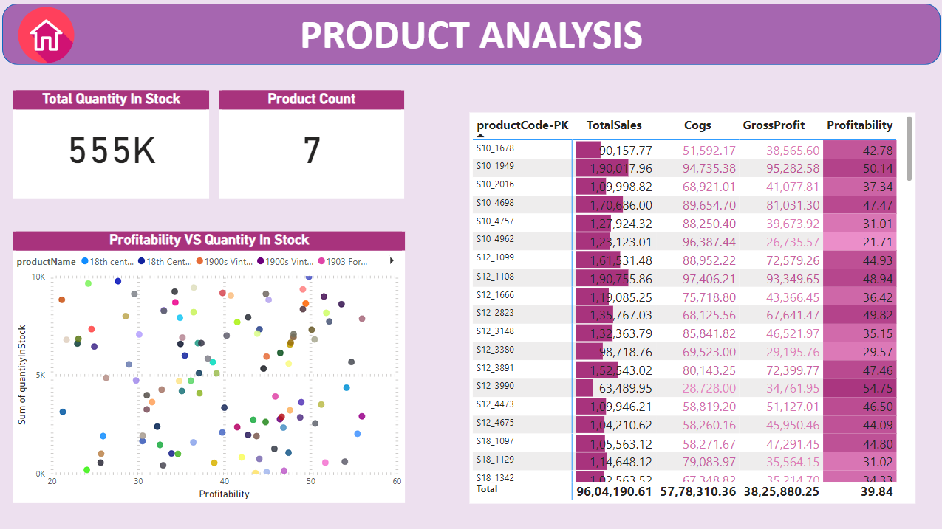

Slide 23
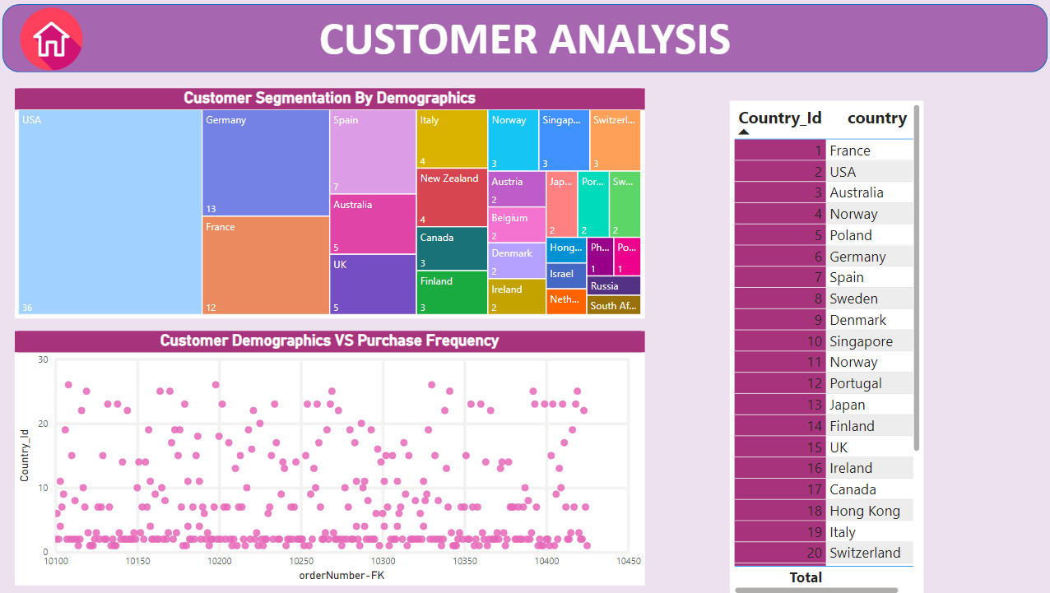

Slide 24
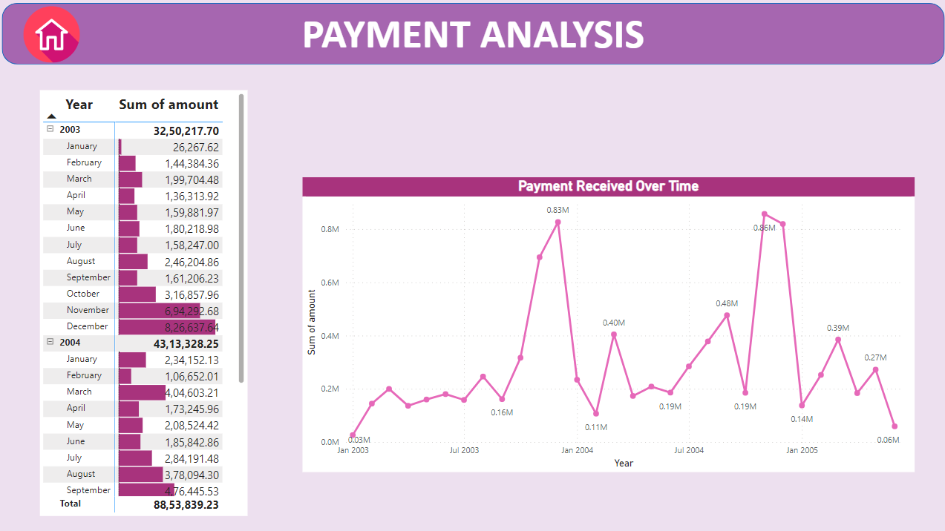

Slide 25
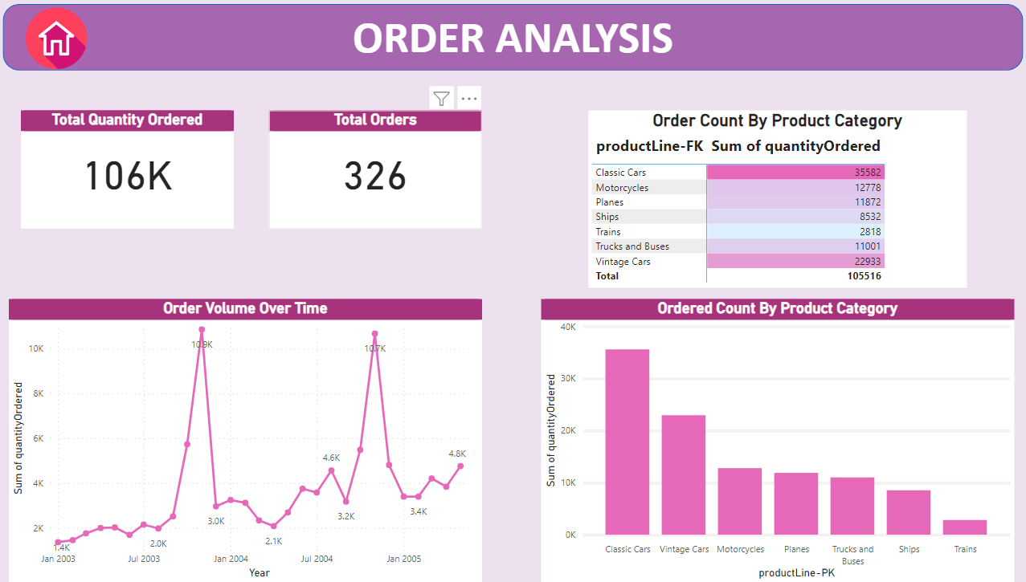

Slide 26
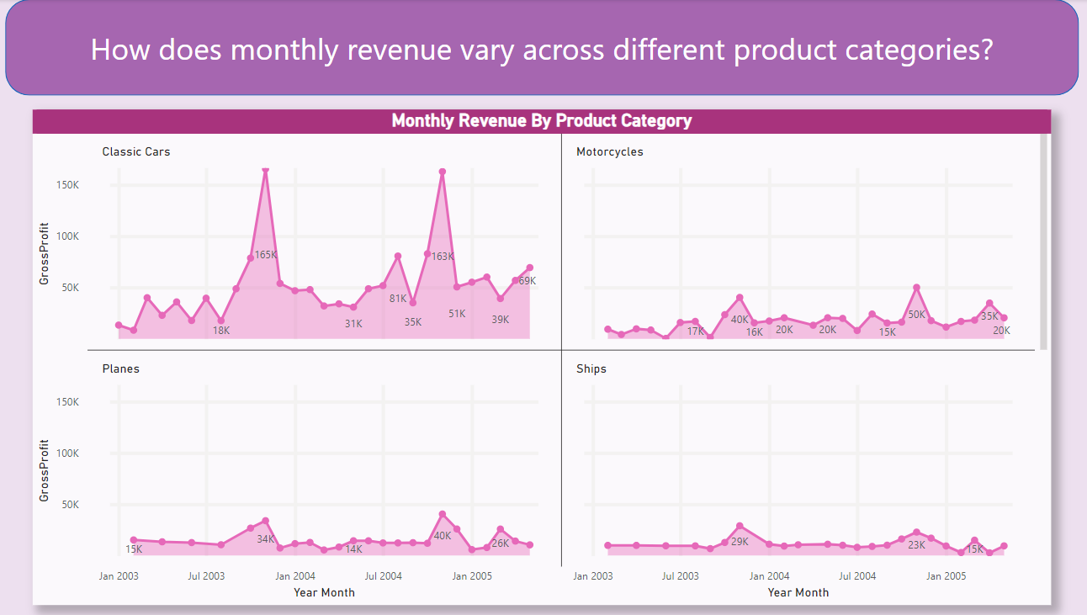

Slide 27
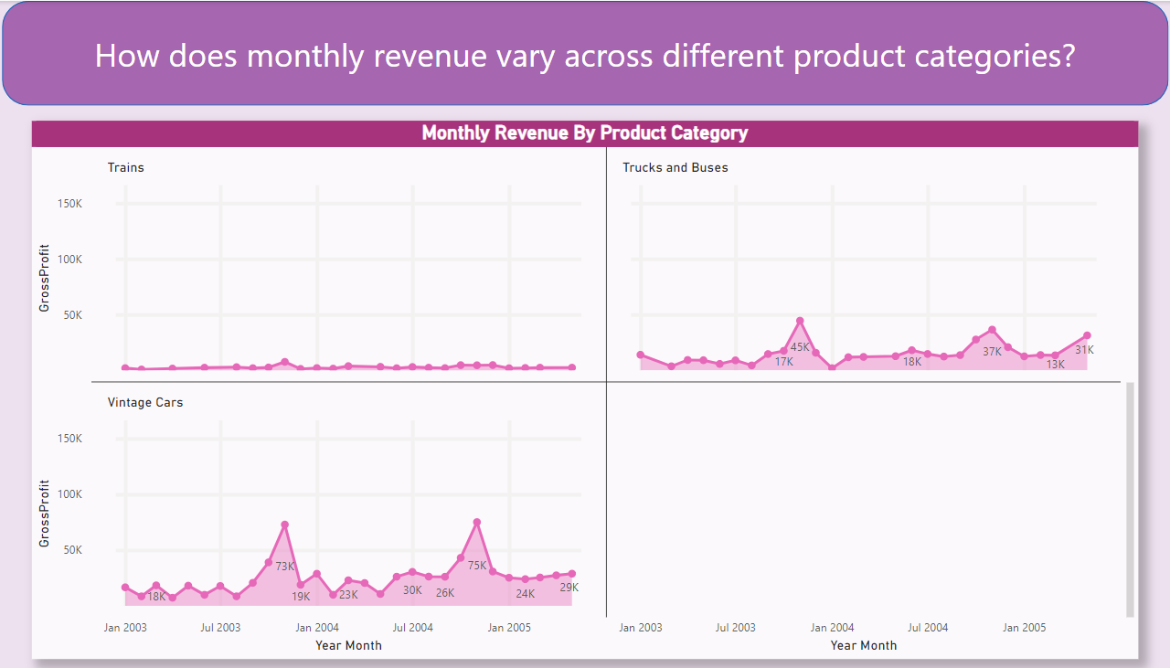

Slide 28
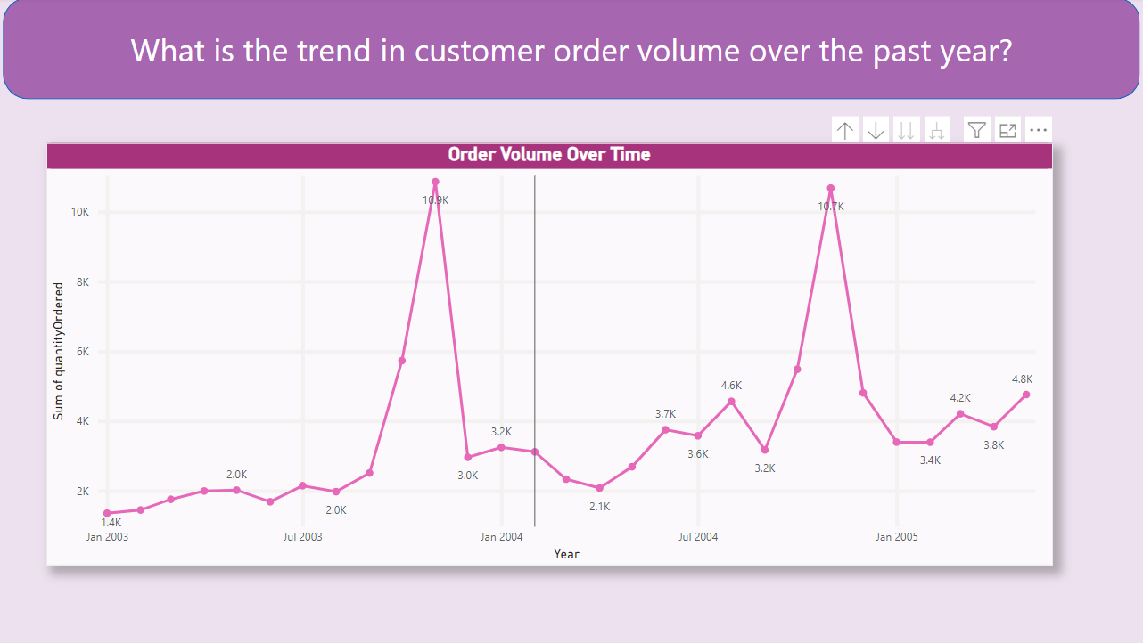

Slide 29
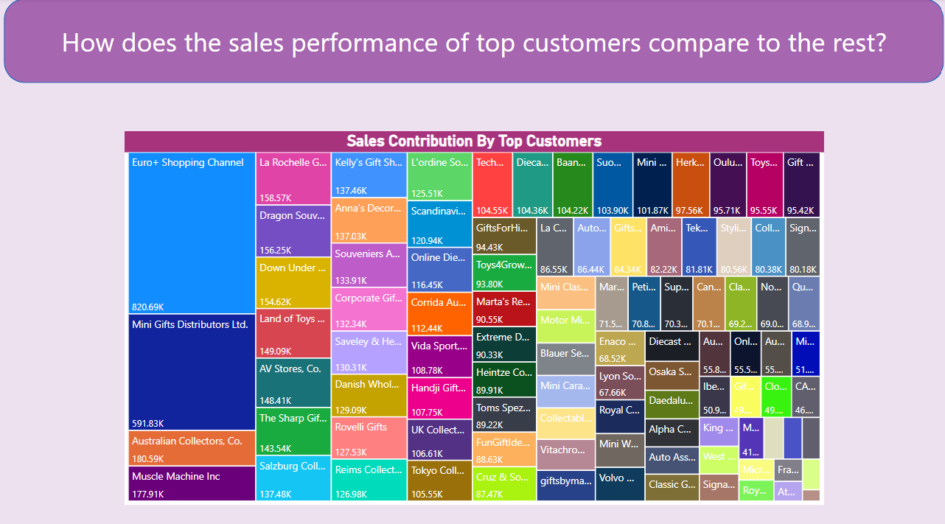

Slide 30
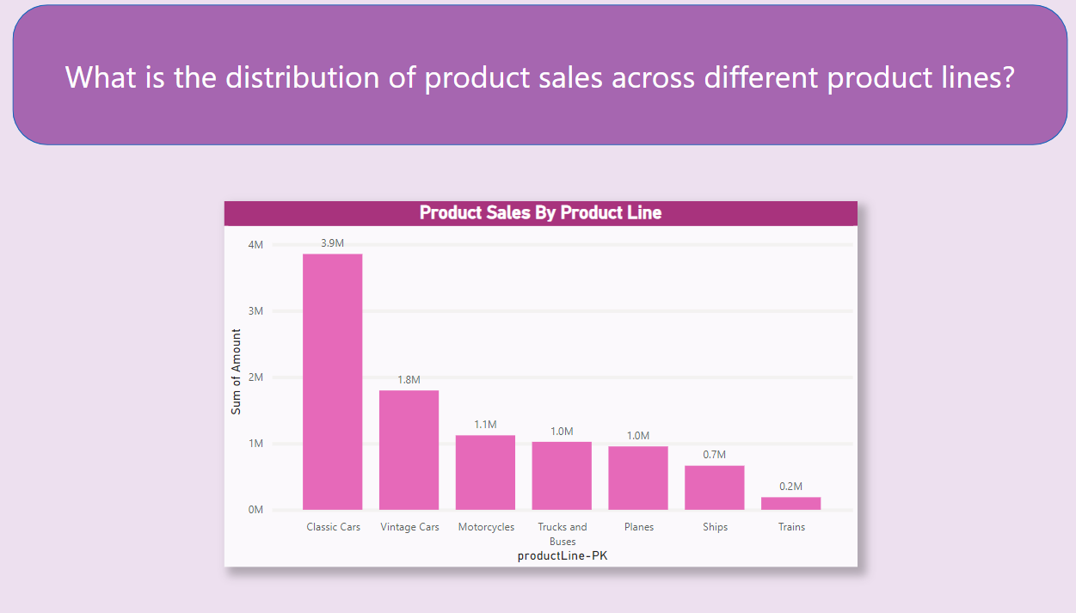

Slide 31
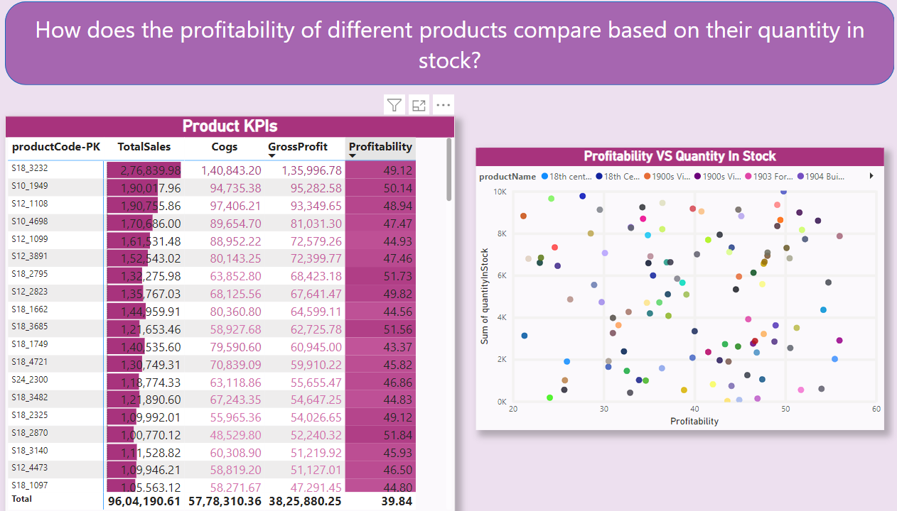

Slide 32
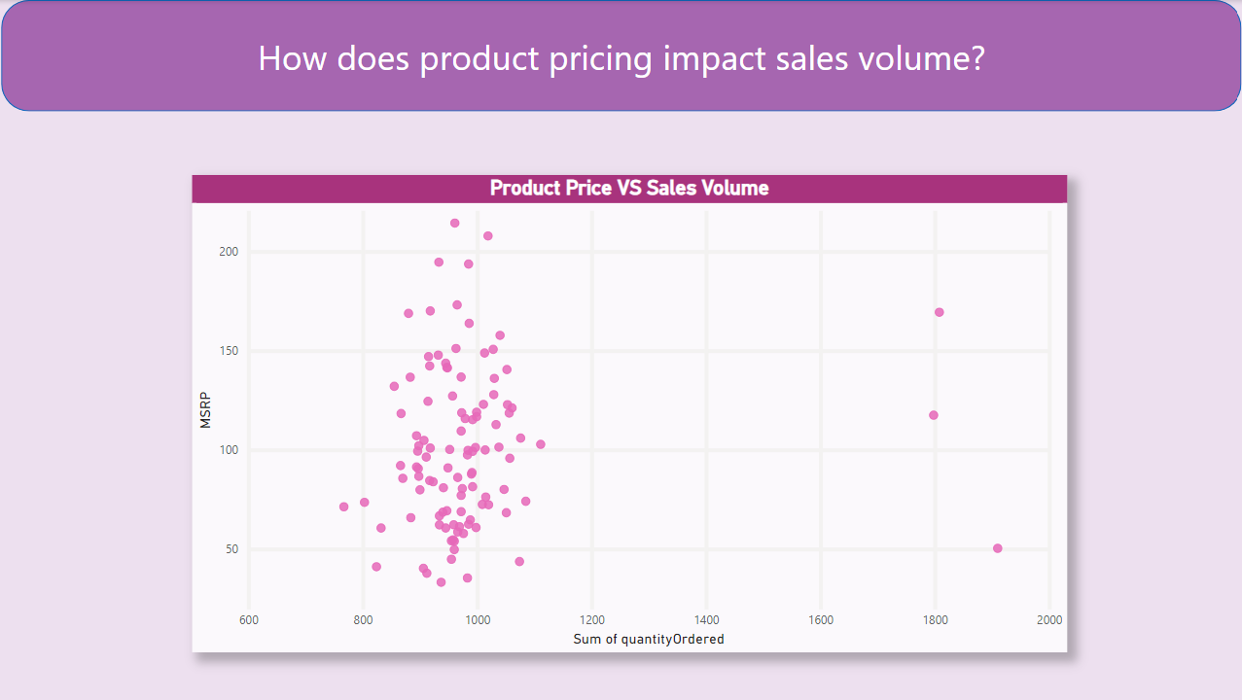

Slide 33
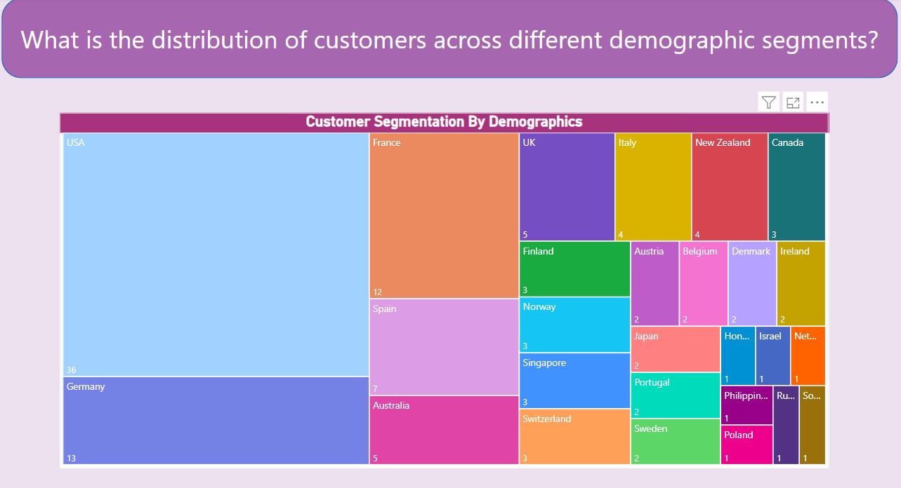

Slide 34
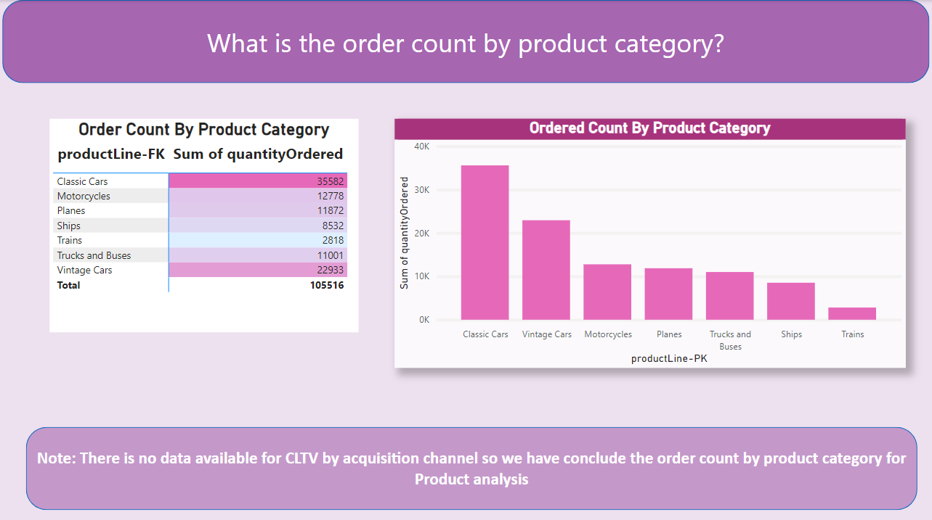

Slide 35
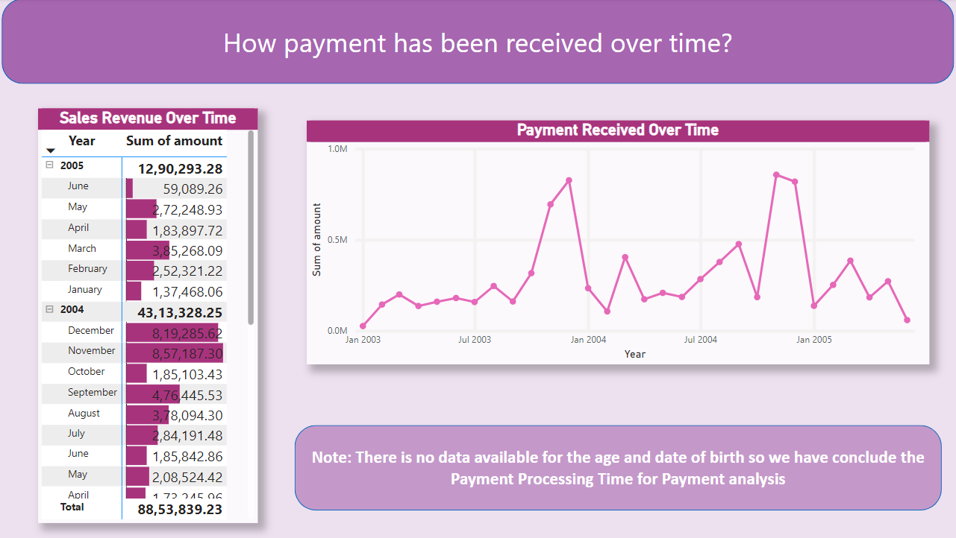

Slide 36
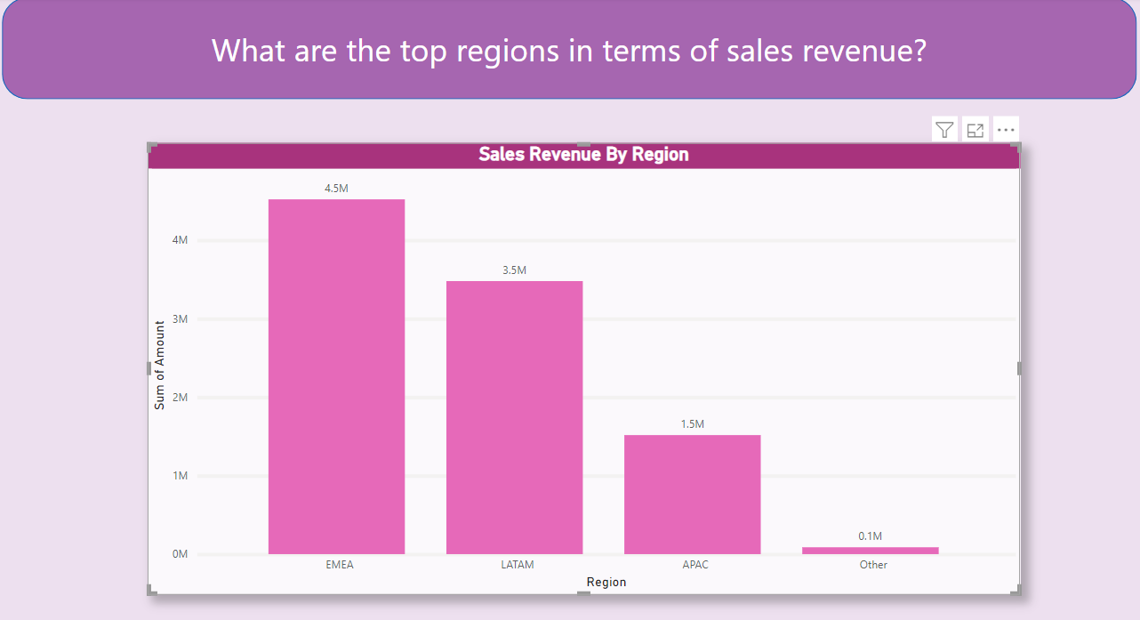

Slide 37
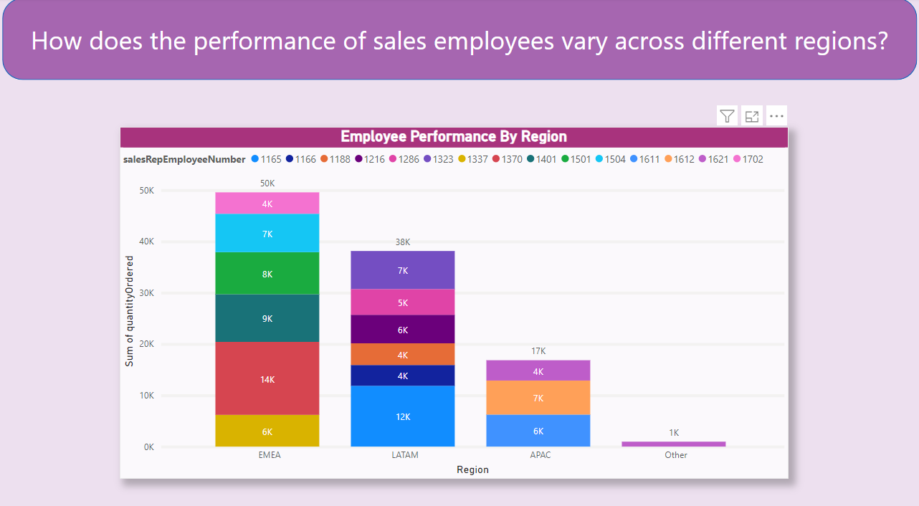

Slide 38
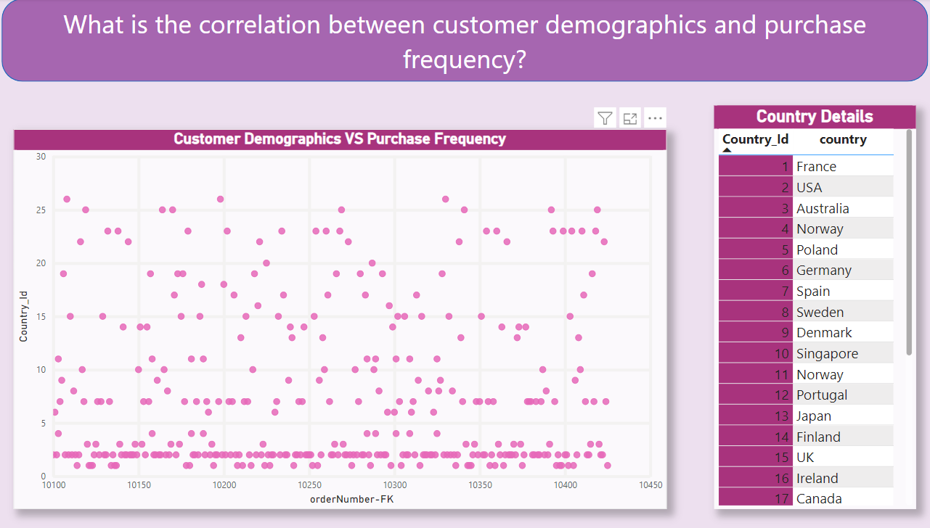

Slide 39
ACKNOWLEDGEMENT
I want to say a big thanks to everyone who played a crucial role in making this project successful. First and foremost, I want to thank the person who created the retail analysis dataset, which was like the foundation of our project. Next, a big thanks to AccioJob for providing me with the platform to learn and improve my skills in data analytics. It was a significant part of my journey.I'm really thankful for all my mentors They have been my guides and helped me learn things like MS Excel, SQL, Power BI, problem-solving, and strategy. I also want to give a special thanks to Siraj Sir. He was there to support me all along, from the beginning of the project to solving problems and challenges during data analysis and creating Power BI reports. Lastly, I want to acknowledge Ammar, the Batch manager of Acciojob Data Analytics Course. He has been a great motivator, helping me to build the confidence and improve my communication, and motivates me to do the work effectively.His support was a big part of the project's success.

Slide 40
THANK YOU
-Akshay Sharma (Data Analyst)

